Slide 1

TEAM-C

Slide 2

INTRODUCTION
About Us:
Electronics distributors of outdoor products sourcing the products from various manufacturers.
Having very less intermediate’s helped us to price up our products very competitively resulting in the rapid increase of the revenue.
Invested into many businesses to drive growth in the net profit.
GO is always looking at opportunities for cost optimization in order to enhance profitability.
Our Market Presence:
America
Europe
Nonexistence in the emerging economies

Slide 3
PRODUCT CATEGORIES
We primarily deal with 5 categories:
Camping Equipment: Second largest contributor ( ~ 35%) to GO’s top line and Gross profit % is ~36% – 37%.
Golf Equipment: Contributes to ~ 15% of the overall revenue and Gross profit is around 18% - 20% higher than the overall average .
Mountaineering Equipment: Contributes to around 10% - 12 % of the top line.
Outdoor Protection: Gross profit is around 50% higher than the overall average.
Personal Accessories: Largest and the best performing category with Revenue share 40+%.

Slide 4
OTHER HIGHLIGHTS
Since 2010, our revenue has been increasing at a rapid rate of > 26% per year on year.
Gross Profit is quite healthy at 40+%.
It has been increasing even as the annual revenue base has been increasing from ~0.91B USD in 2010 to 1.5 B USD in 2012.
One of the major factors contributing to the increase in profits is the reduction in the share of telephone and “sales visit” driven sales .
Due to which there is an increase in the share of web and email driven order
In 2012, web contributed to 89.6% of all the orders (by value).
In 2013, for the first seven months, web contributed to 91.1% of all the orders (by value)
In 2013, email contributed to 1.6% of all the orders (by value).
In 2013, for the first seven months, web contributed to 1.5% of all the orders (by value)
The major concern for the GO leadership is aiming to go public in order to raise funds for future growth.

Slide 5
PRESENT APPROACH
•Minimize the Impact of Returns on Net Sales
•Increase share of Outdoor Protection
•Reduce Share of Orders from Sales Visits
•Reduce Retailer Inventory Costs
•Maintain Revenue Growth
•Increase Retailer Throughput

Slide 6
CURRENT IT ENVIRONMENT
•Limited Legacy Systems
•TIBCO for Enterprise Integration
•Cognos-Powered BI Solution

Slide 7
RETURNS REDUCTION PROJECT
Objective: The main objective of the Returns Reduction Project is to enhance profitability by minimizing the financial impact of product returns. To achieve this, the project focuses on implementing a strategy that leverages the current IT implementation and enhances it as needed.
Key Points:
Return Minimization
Microservices Architecture
Enhanced IT Implementation
Loose Coupling

Slide 8
FUNCTIONAL REQUIREMENTS
ORDER MANAGEMENT:
Reduction of Order received from “Sales visits”. Redirection of these orders either through the web
Retailer Incentives for Order Mix Change
Reporting and Alerting Mechanisms
Reduction in Sales Folks' Bonuses
Reporting and Alerting Mechanisms for Bonus Reduction

Slide 9
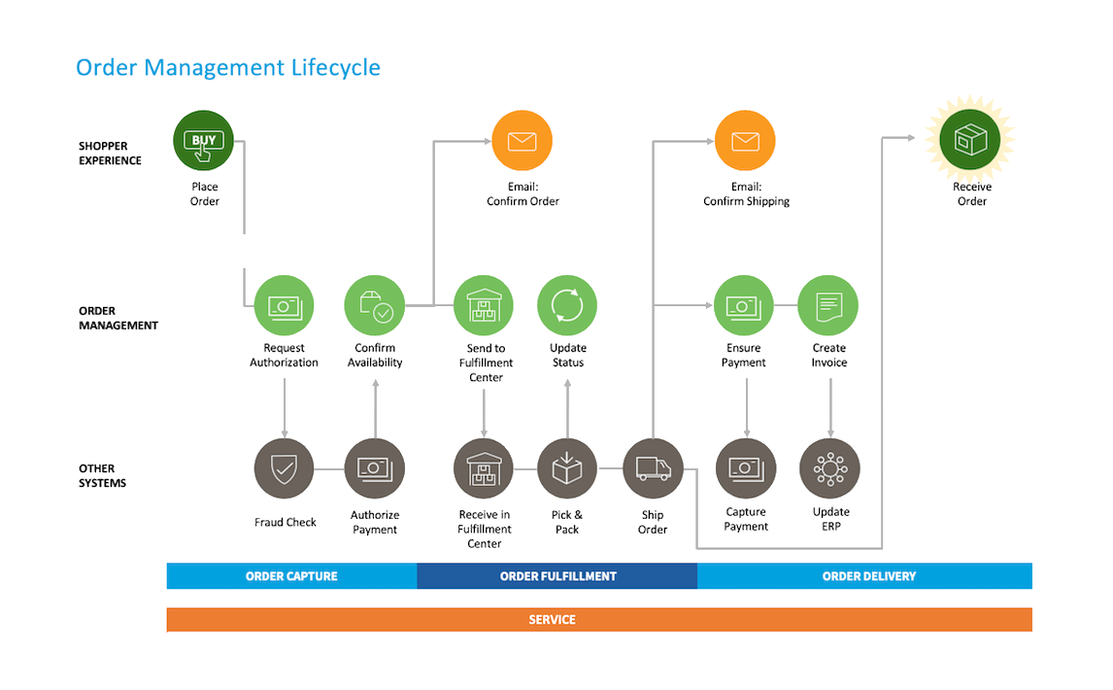
ORDER MANAGEMENT LIFECYCLE

Slide 10

CHANGE REVENUE MIX
Promotional Discounts on Outdoor Protection
Gross Profit Protection
Monitoring Revenue Changes
Color-Coding for Performance
Alerts for Discount Targets

Slide 11
RETURNS MANAGEMENT
Reduce Returns by targeting the categories that is in the direct control of GO Operations (where there is no or minimal dependence on the customer):
Incomplete Product
Wrong Product Shipped
Color code the change
Green – value of reduction ( in a given period) is >= 10%
Amber – value of reduction is >= 3% but < 10%
Red – value of reduction is < 3%
Based on analysis, below are the primary causes for the returns:
Inadequate product specification details while ordering.
Default shipping address was selected to deliver the products to the customers.
Below are the functional requirements to eradicate above mentioned causes of returns:
Build Product Master:
Manage Product Shipping Addresses:
Maintain Customer Addresses List

Slide 12
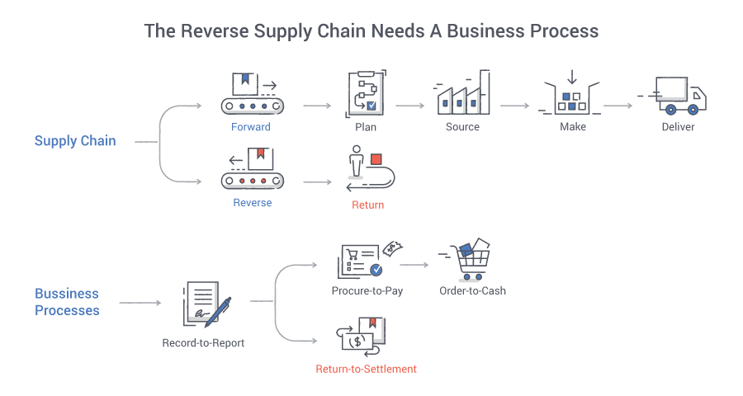
RETURNS MANAGEMENT LIFE CYCLE

Slide 13
RETAIL STORE INVENTORY
Reduce the inventory at Retail stores:
Reducing Retail Store Inventory
Reporting on Item Shelf Time:
Tracking Changes:
Tracking Warehouse-to-Retailer Delivery Time:
Finding Outliers:
At Product Category Level:
At Item Level within Outlier Categories:
At Item Level (Regardless of Category):

Slide 14
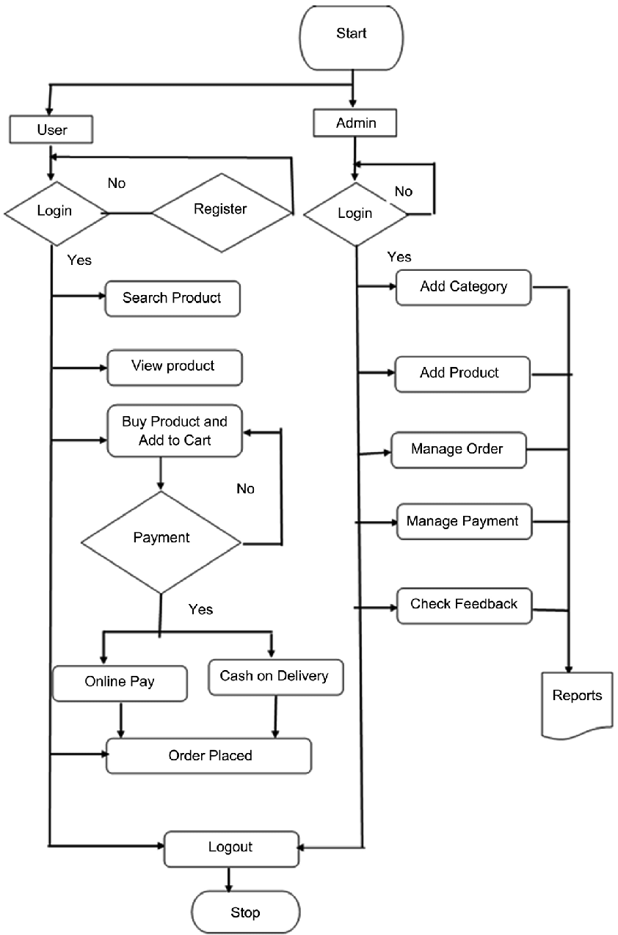
RETAIL STORE INVENTORY

Slide 15
NON FUNCTIONAL REQUIREMENTS
1)Performance Requirements:
All canned reports should be published in < 10 seconds
All ad hoc reports should be published in < 5 seconds
Product Master screen should not take more than 2 sec to create a product
Customer Order screen should be able complete submission of customer order within 3 sec including all validations on shipping address.
Customer Address List screen should not take more than 2 sec.
2) Operations and Reliability:
Describe the up time requirements
Acceptable data loss
System update (release, reconfiguration) requirements.
3) Disaster Recovery Requirements:
It is a recorded policy and/or process that is designed to assist an organization in executing recovery processes in response to a disaster to protect business IT infrastructure and more generally promote recovery.
4) Platform Requirements:
It is often necessary to explicitly specify the platform requirements for the development of software so that it will be easy to analyze.
33%
22%

Slide 16
DIAGRAMS

Slide 17
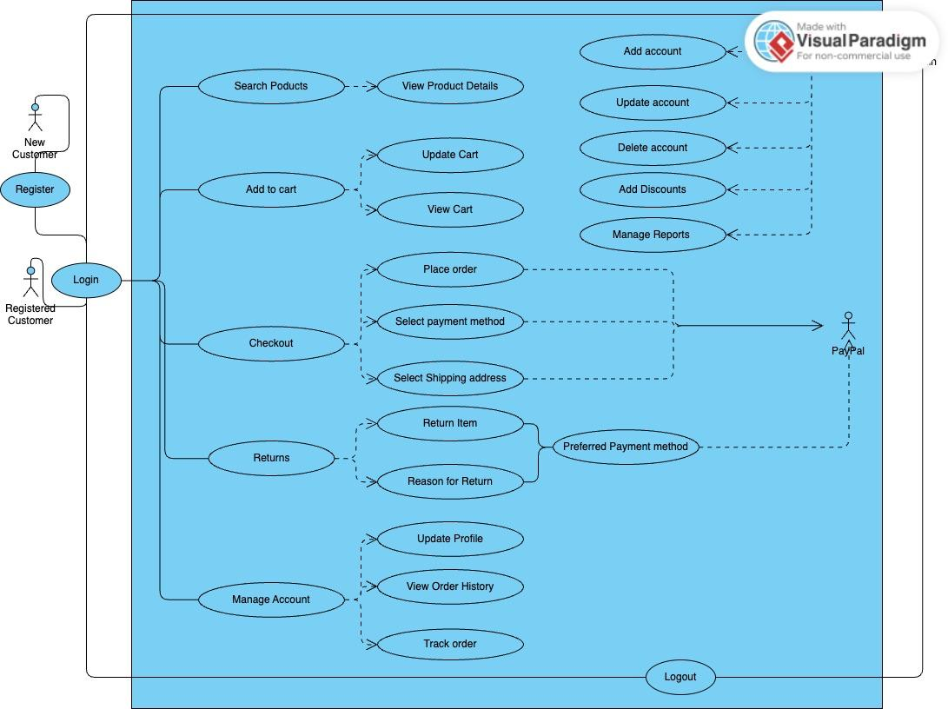
USE CASE DIAGRAM

Slide 18
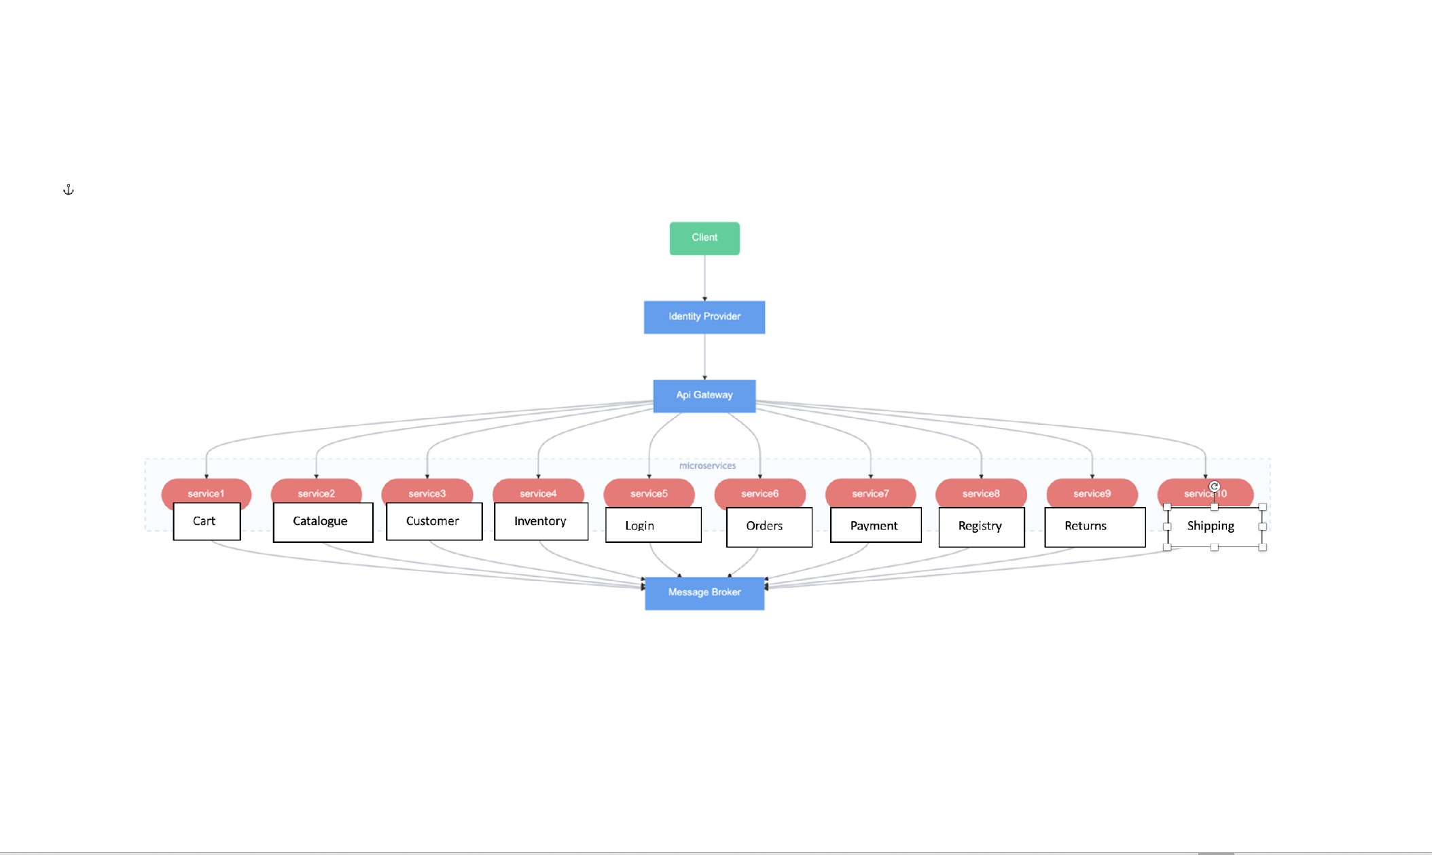
ARCHITECTURE

Slide 19
FLOW CHART

Slide 20
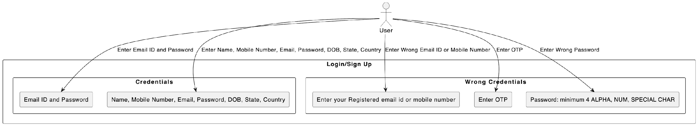
LOGIN/SIGNUP USE CASE DIAGRAM

Slide 21
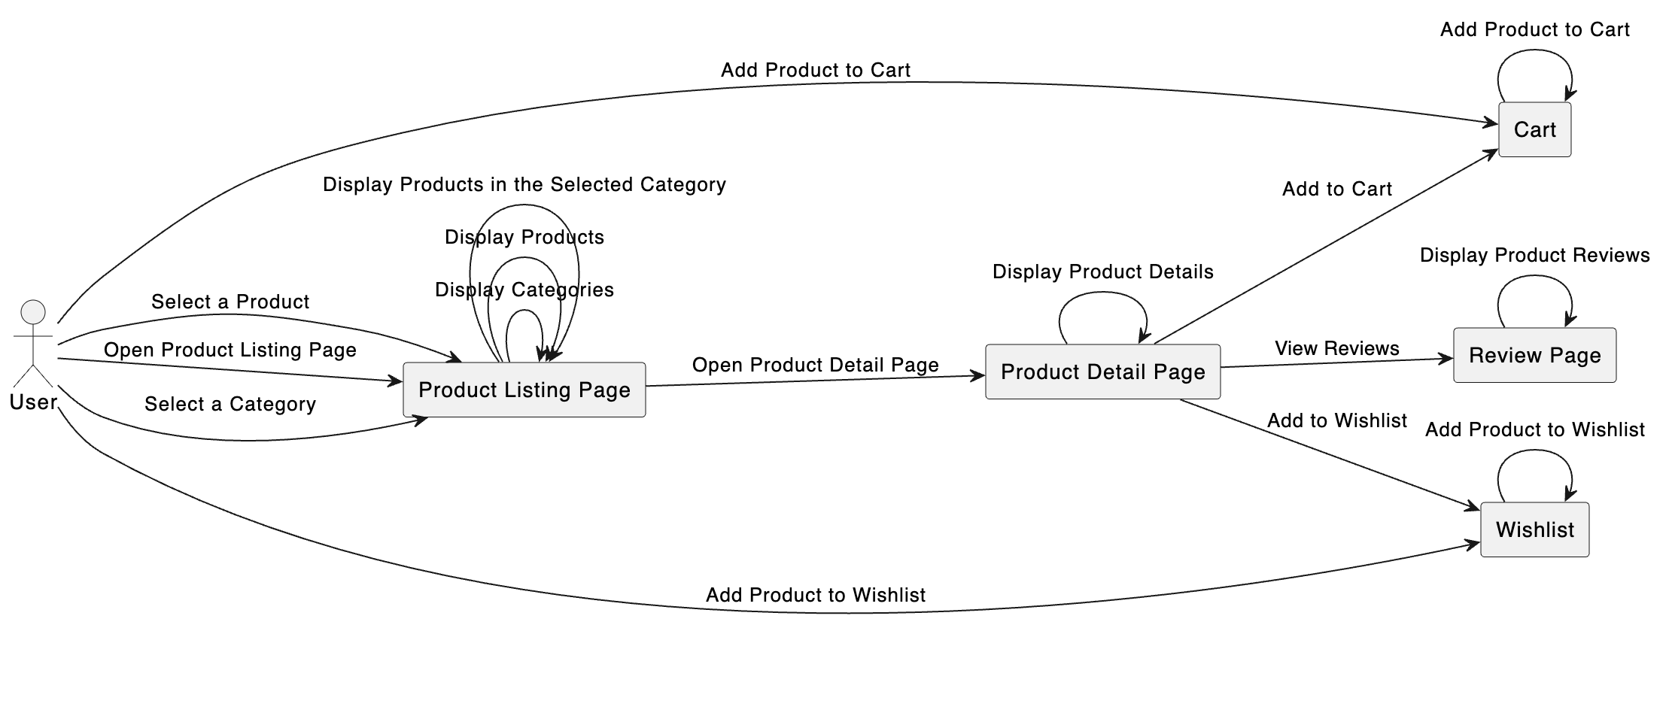
CATALOGUE USE CASE

Slide 22
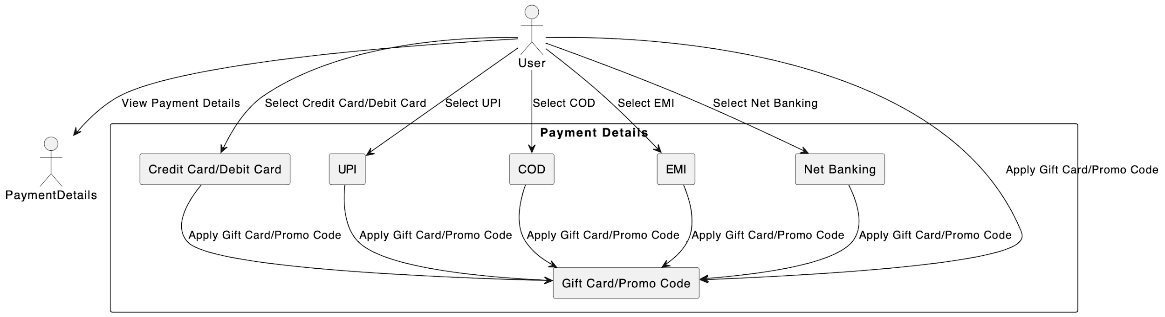
PAYMENT USE CASE

Slide 23
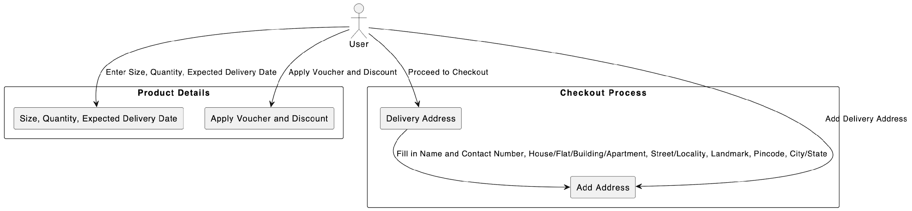
CART USE CASE

Slide 24
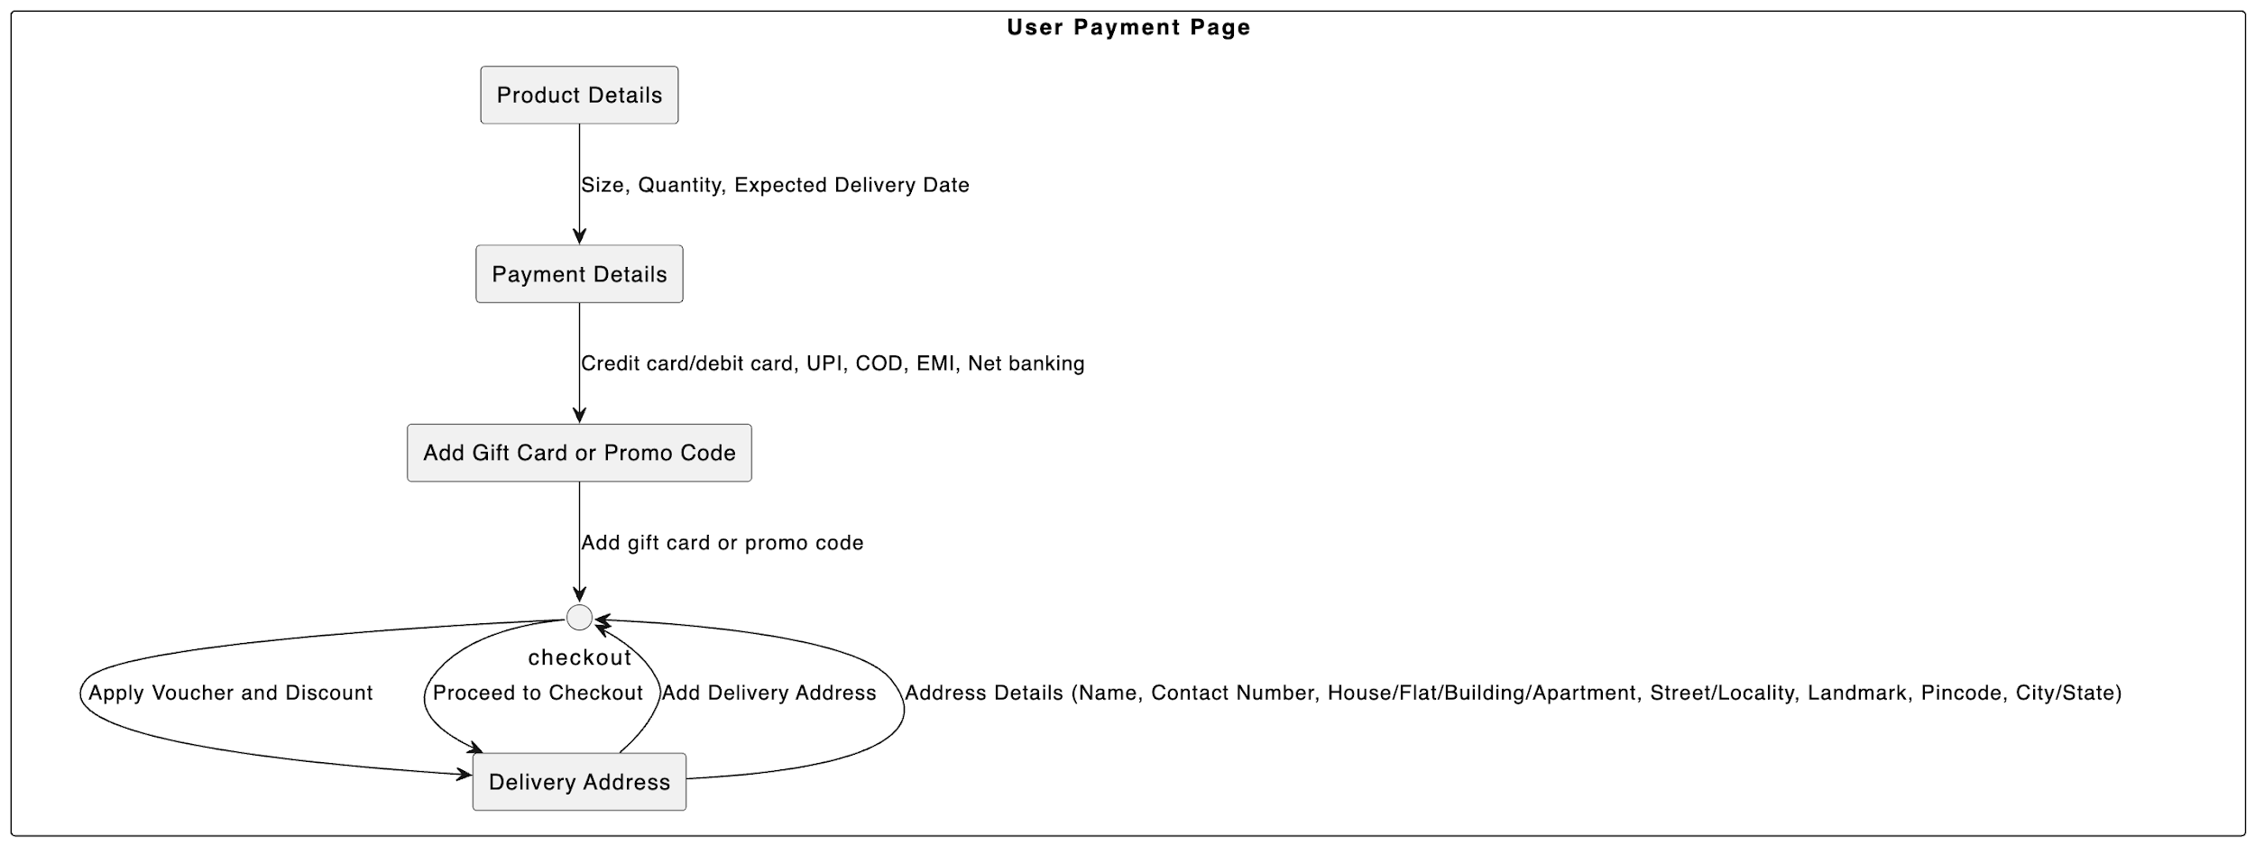
USER PAYMENT PAGE

Slide 25
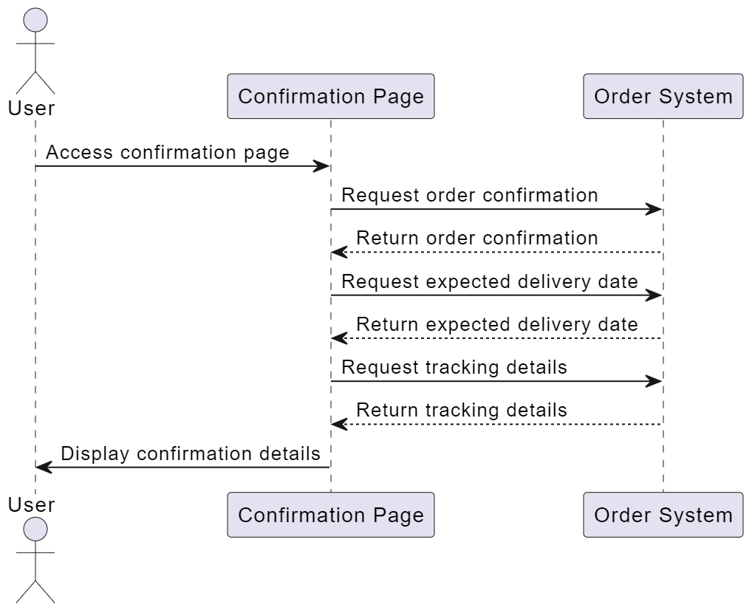
SEQUENCE DIAGRAM: USER CONFIRMATION PAGE

Slide 26
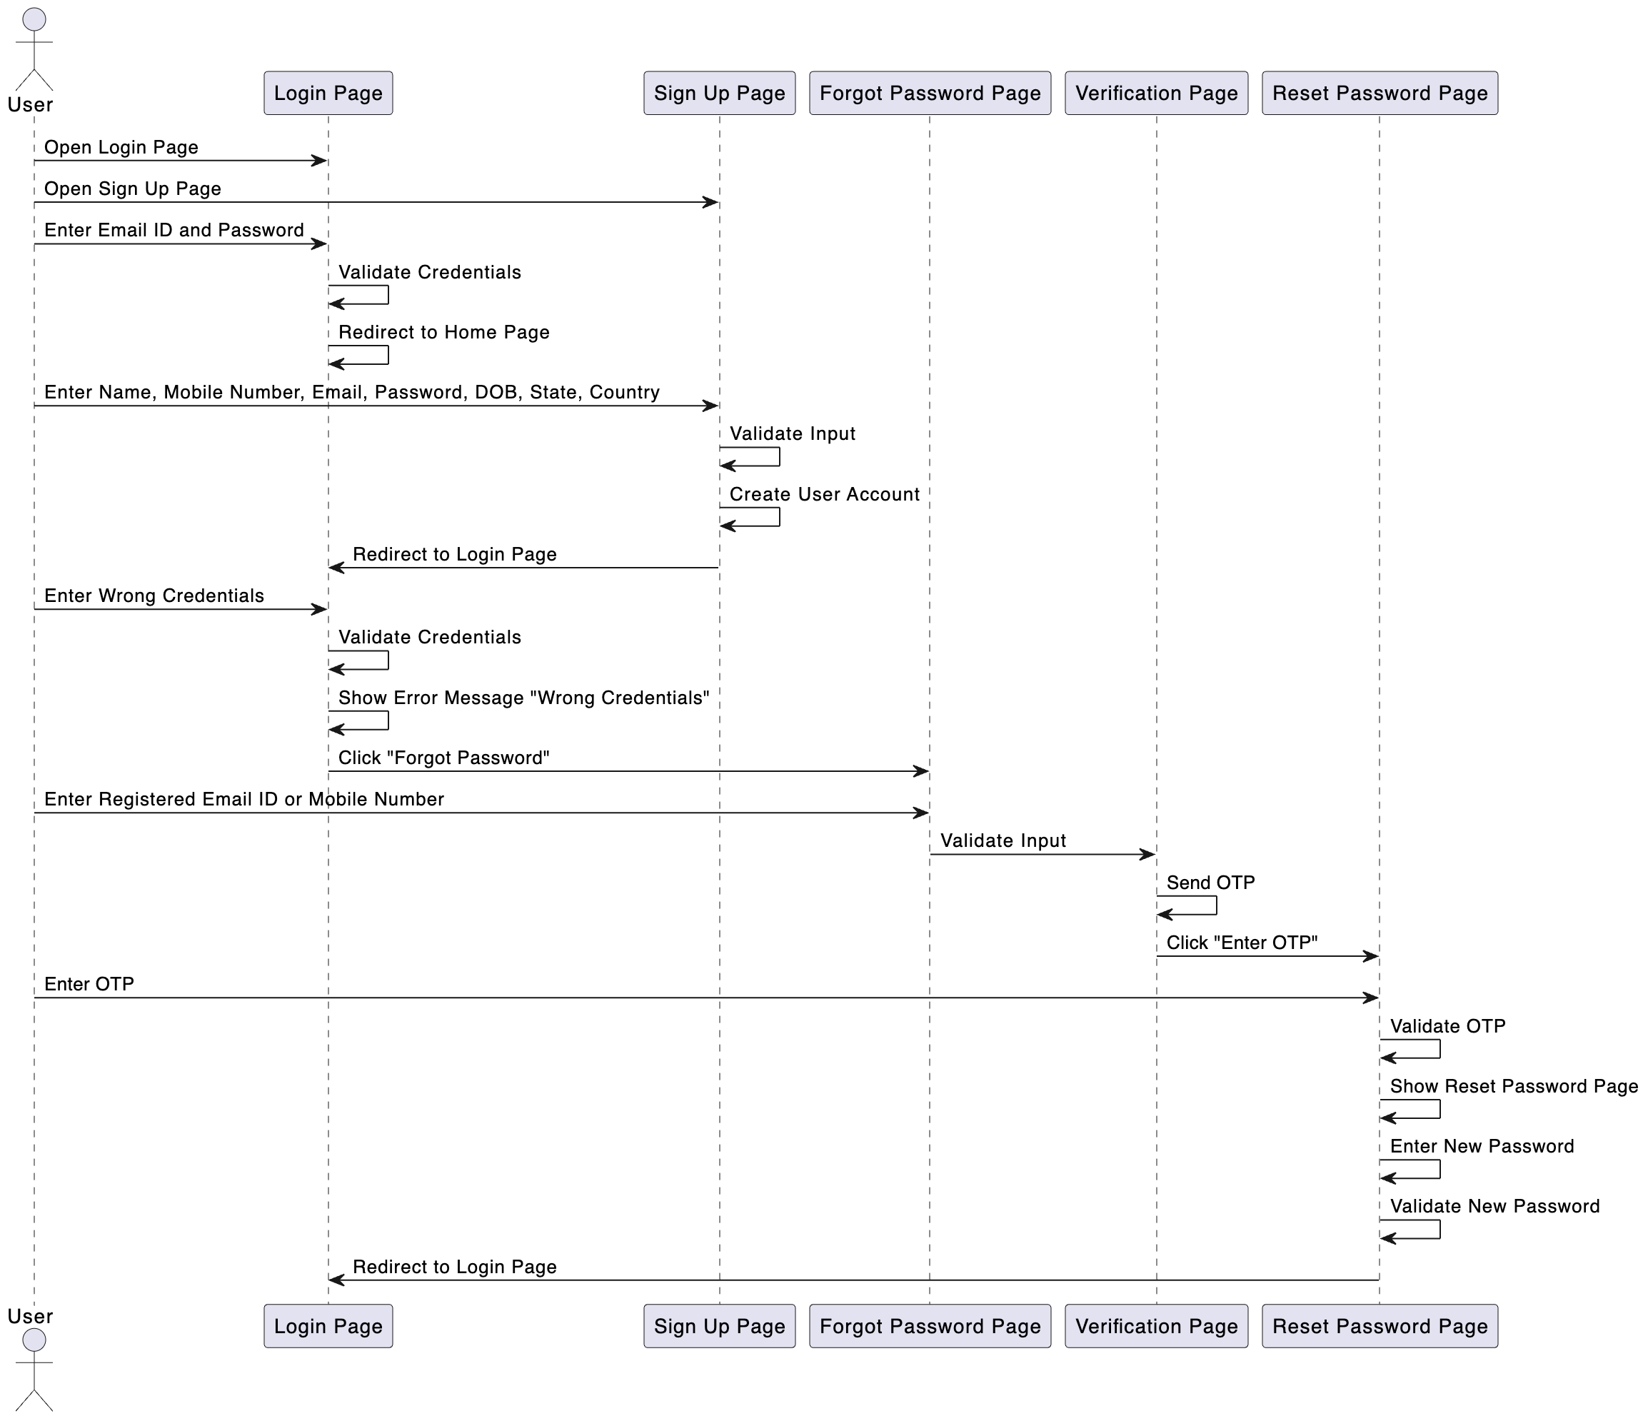
USER LOGIN PAGE

Slide 27
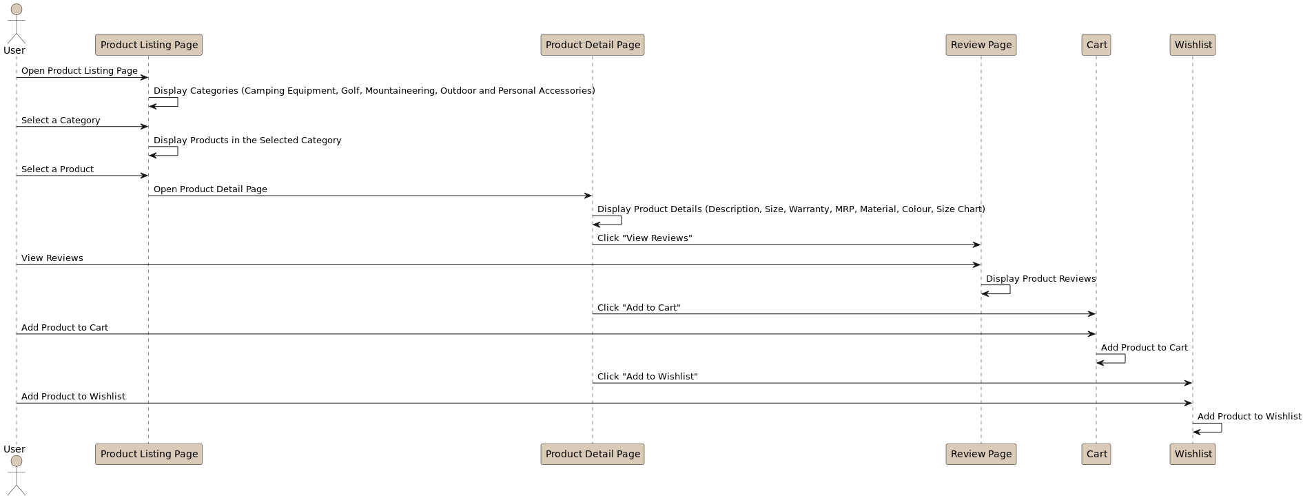
USER CATALOGUE PAGE

Slide 28
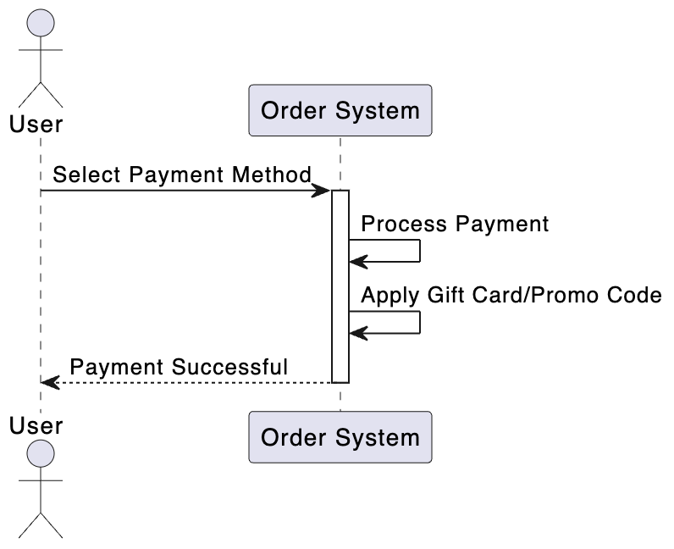
USER PAYMENT PAGE

Slide 29
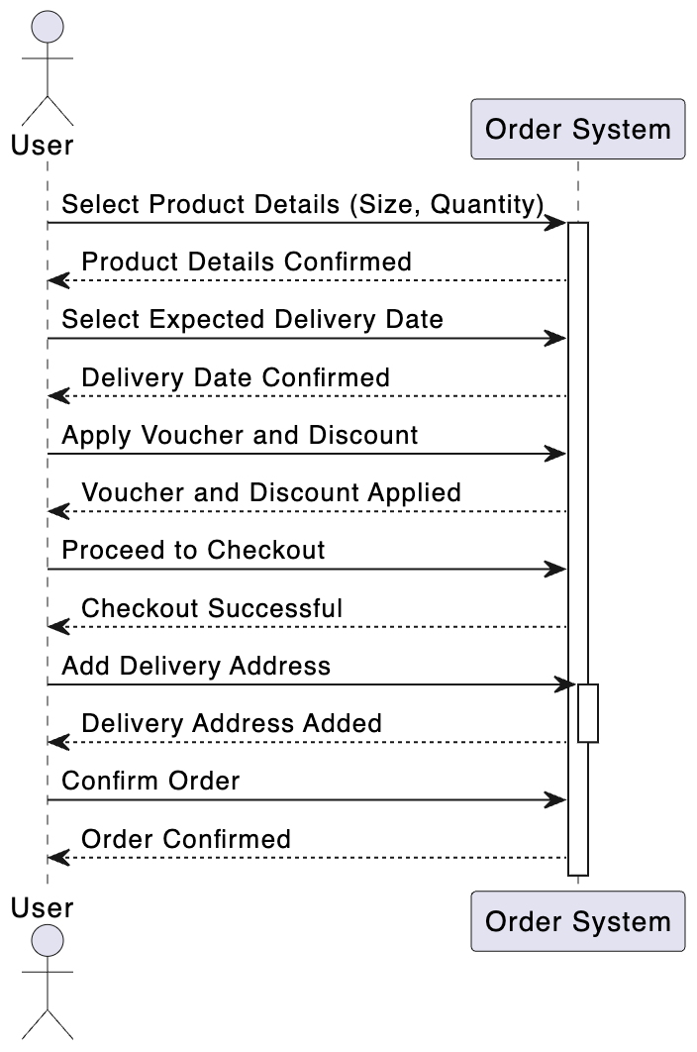
USER CART PAGE

Slide 30
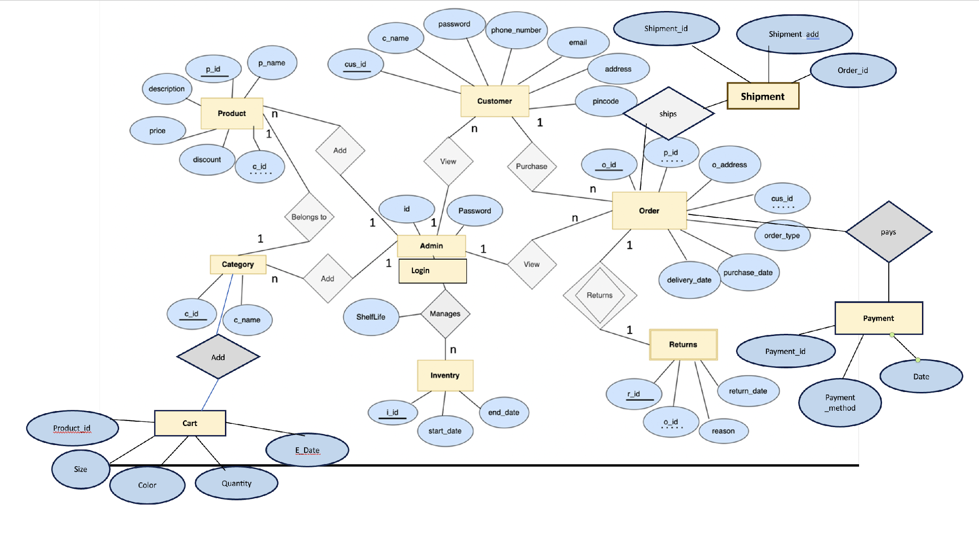
ER DIAGRAM

Slide 31
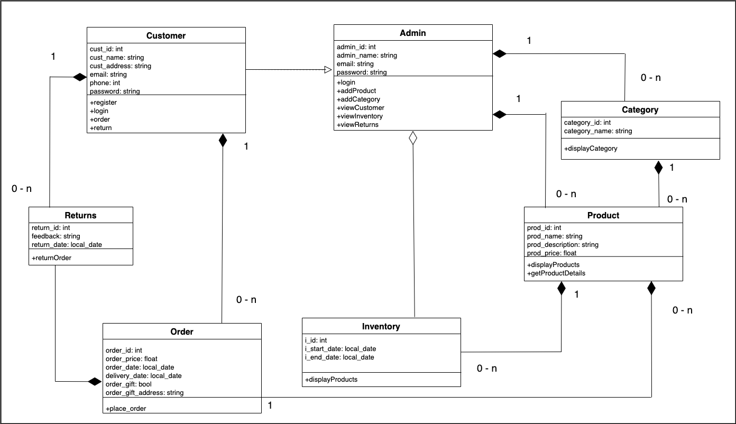
CLASS DIAGRAM

Slide 32
SCREENSHOTS OF THE FINAL PROJECT

Slide 33
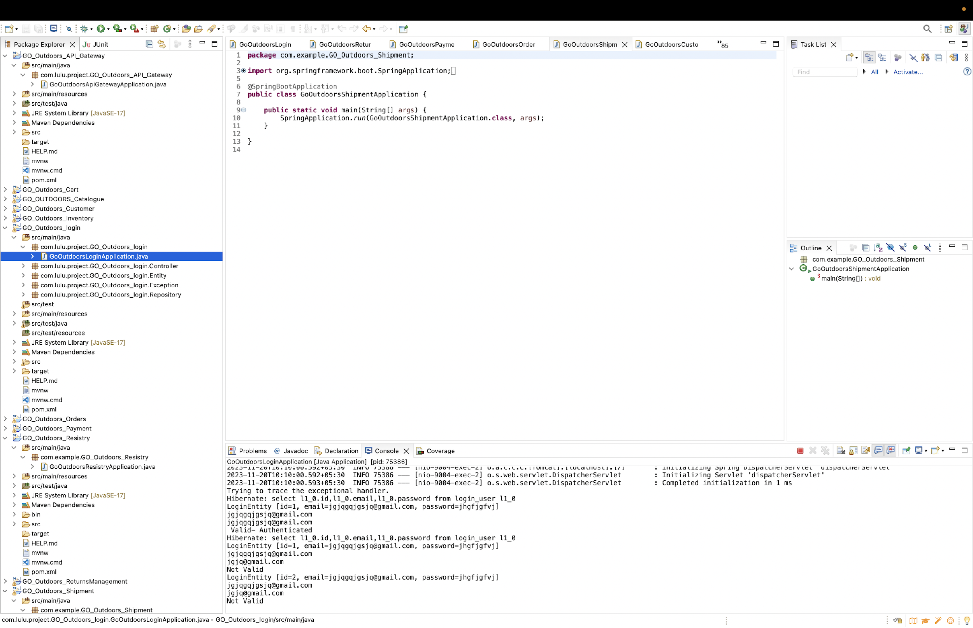
Creation of 10 microservices

Slide 34
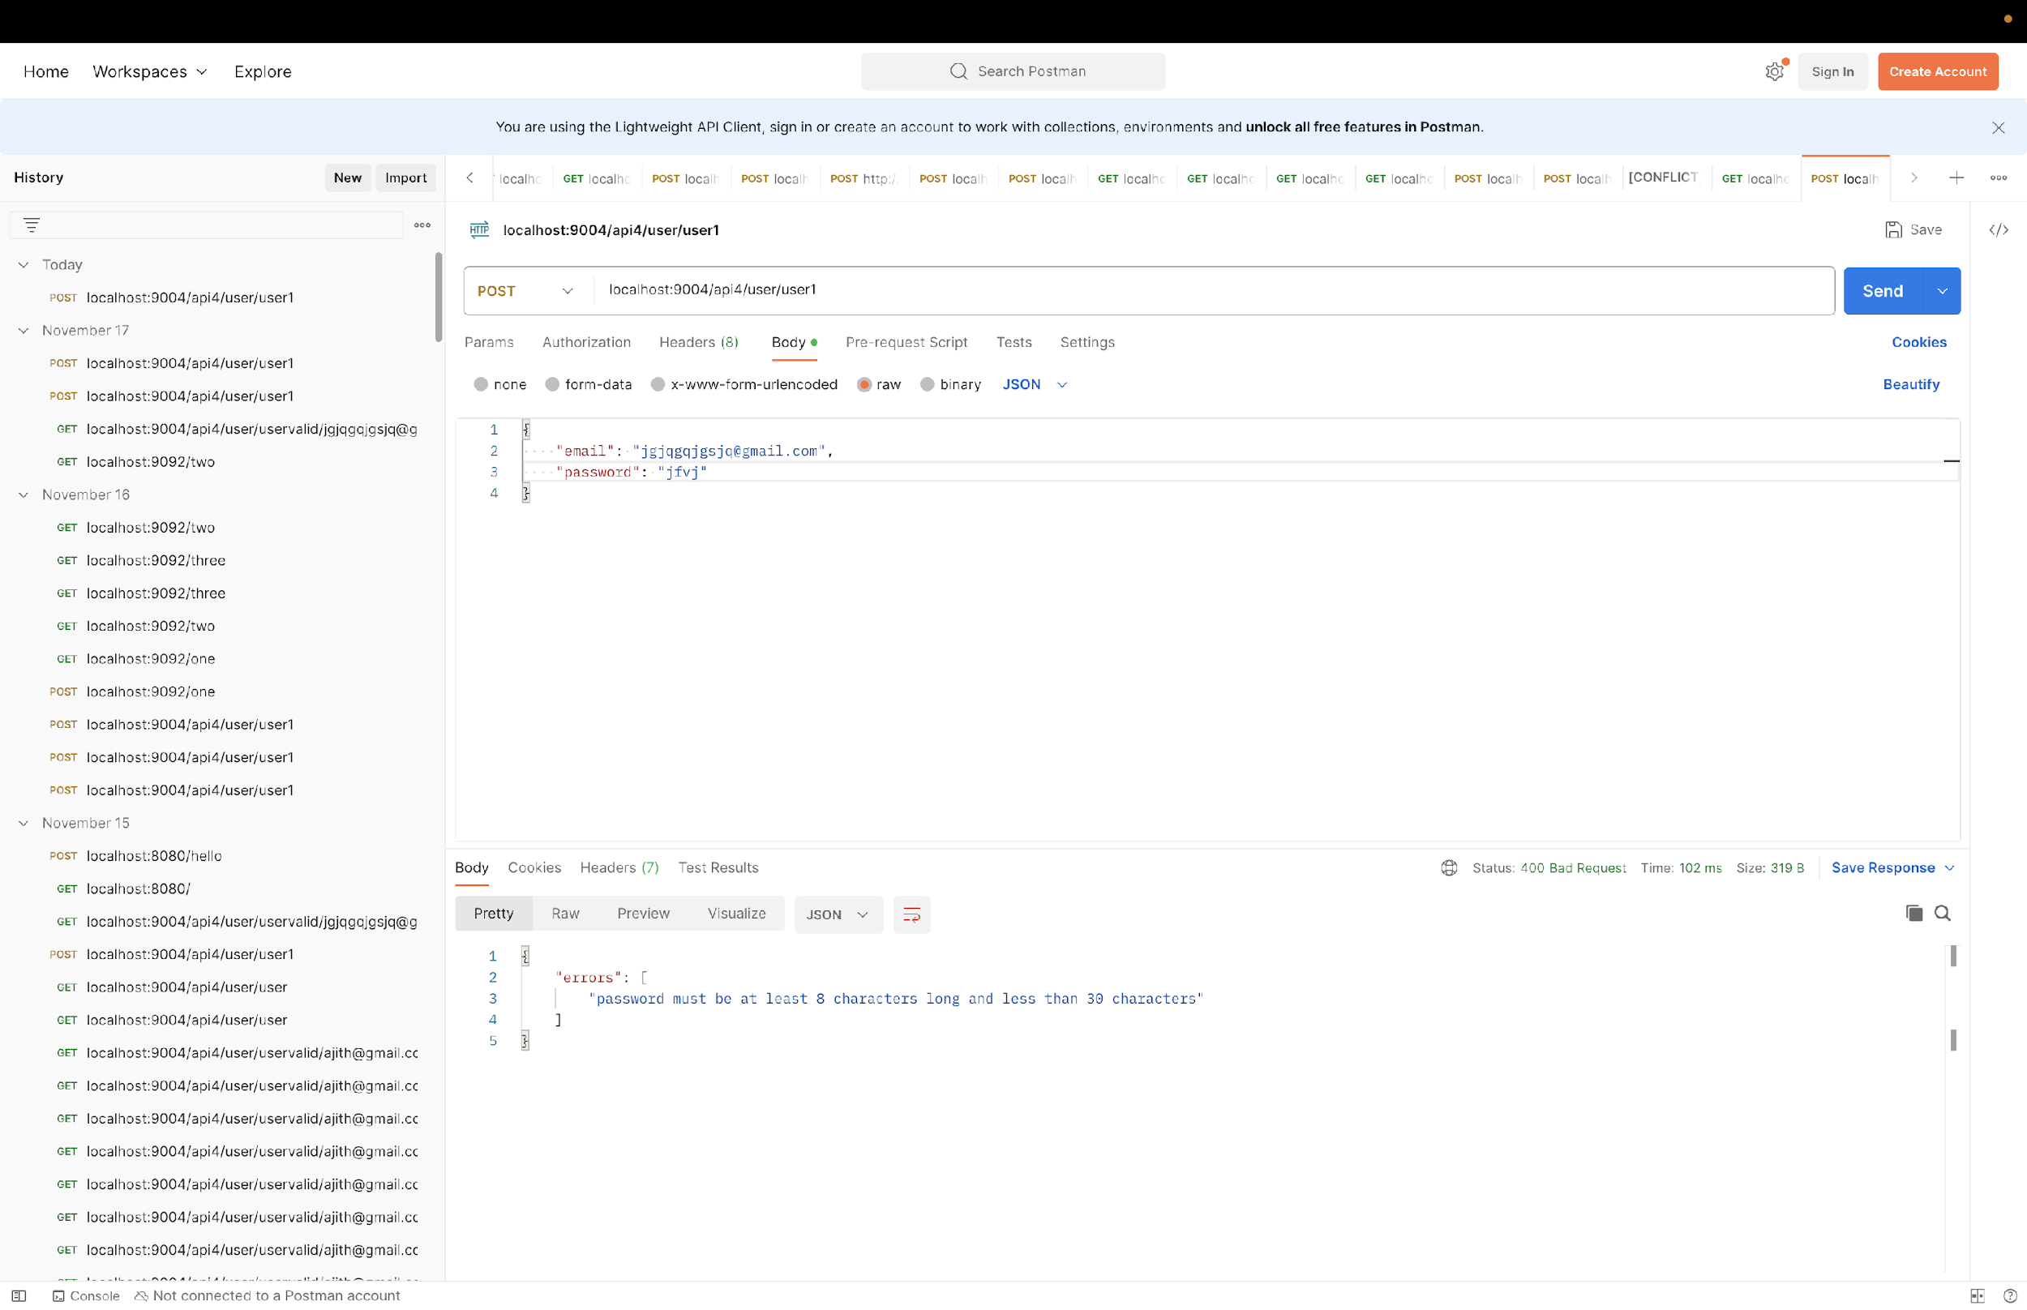
Screenshot showing an error for invalid password

Slide 35
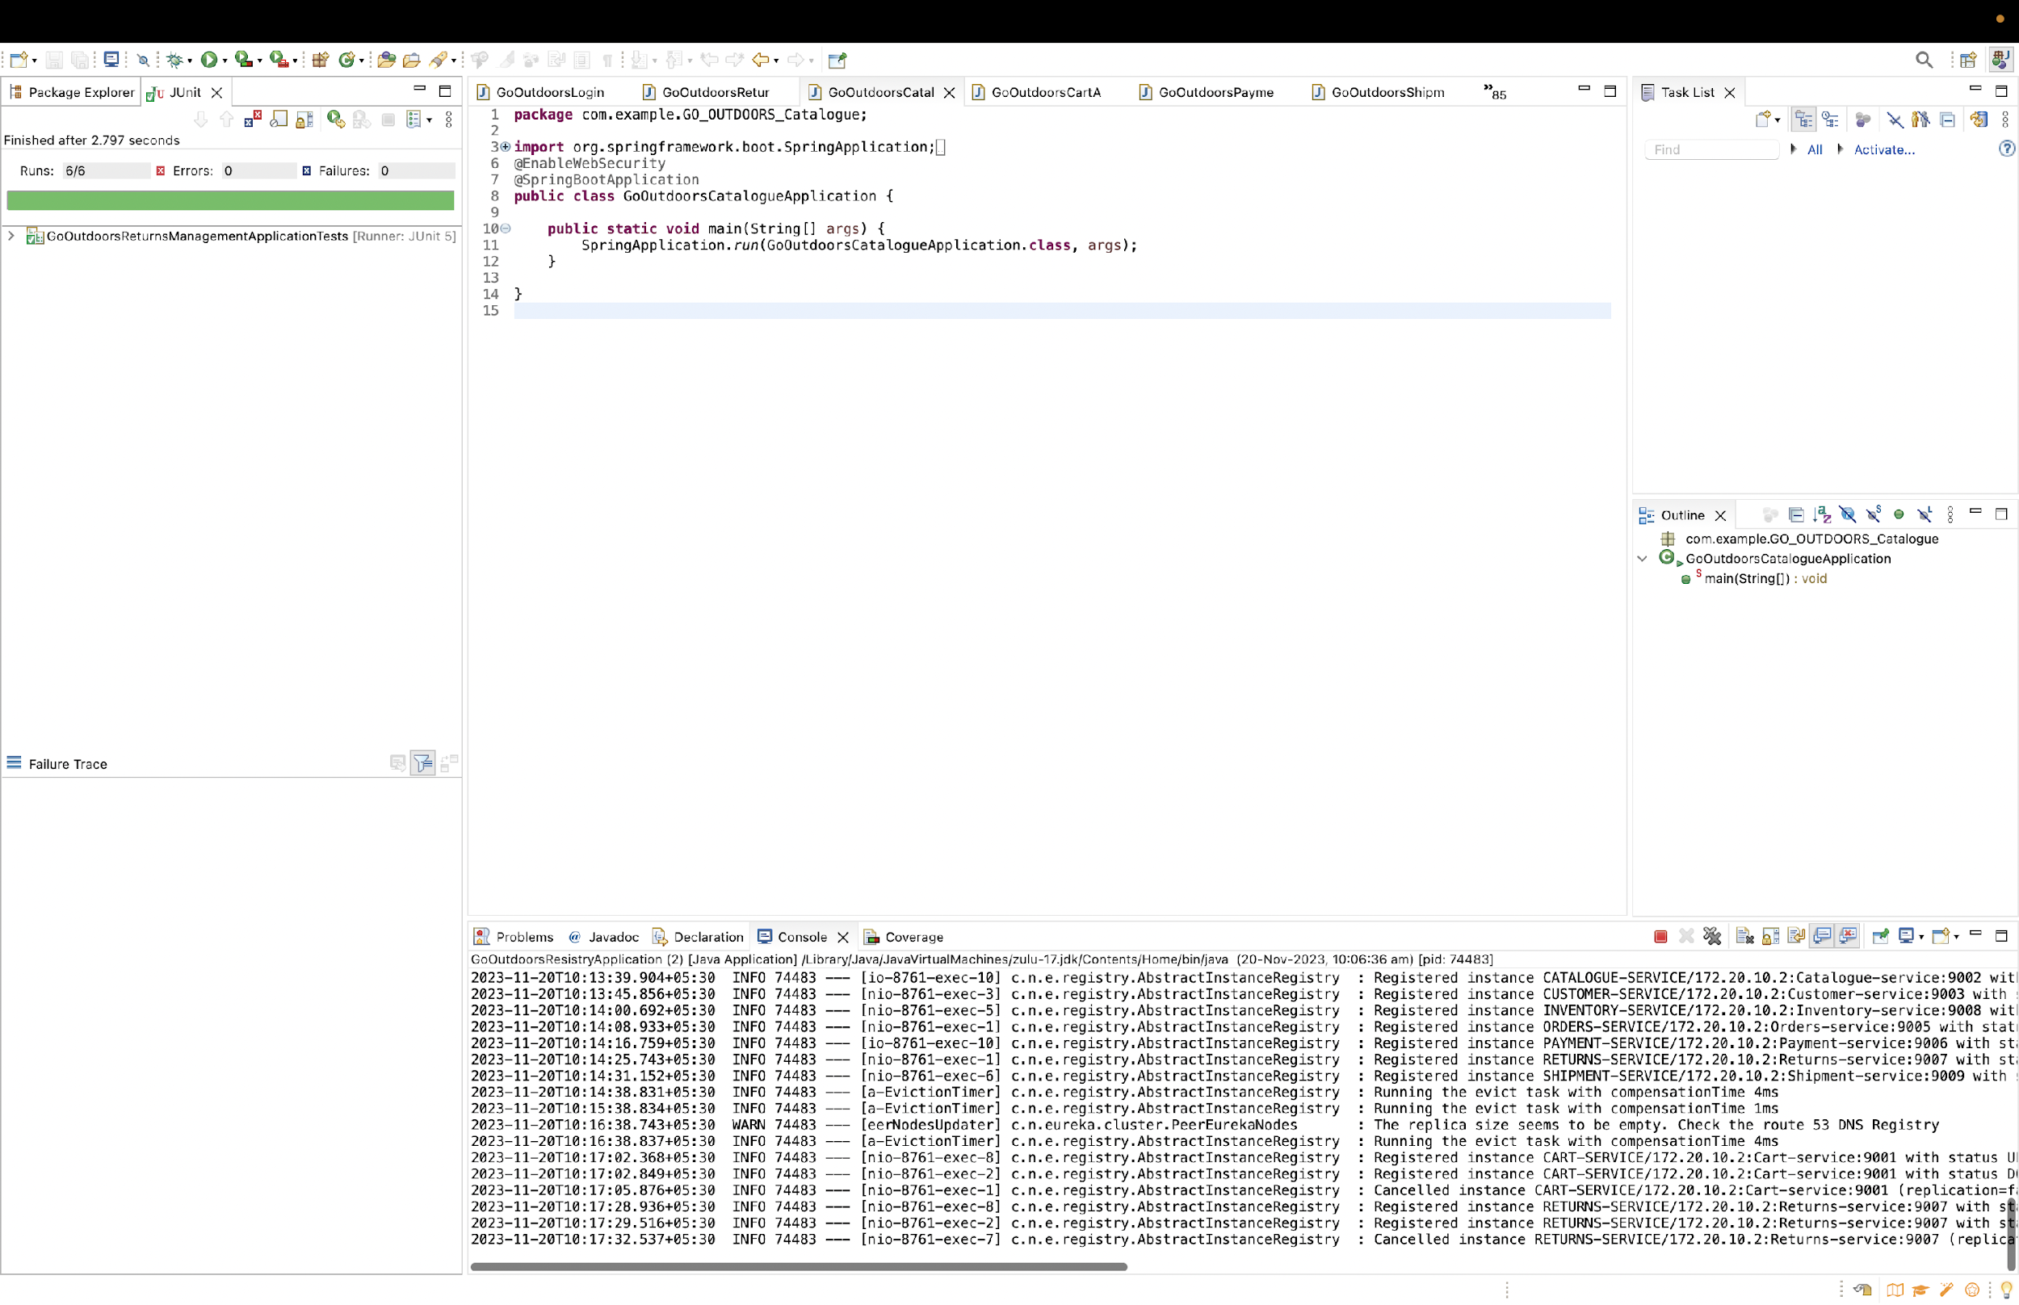
Working of testcases on all 10 Microservices

Slide 36
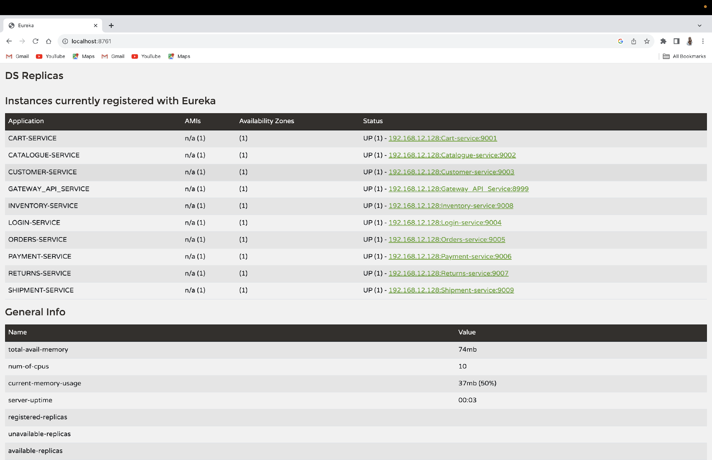
The Eureka Server

Slide 37
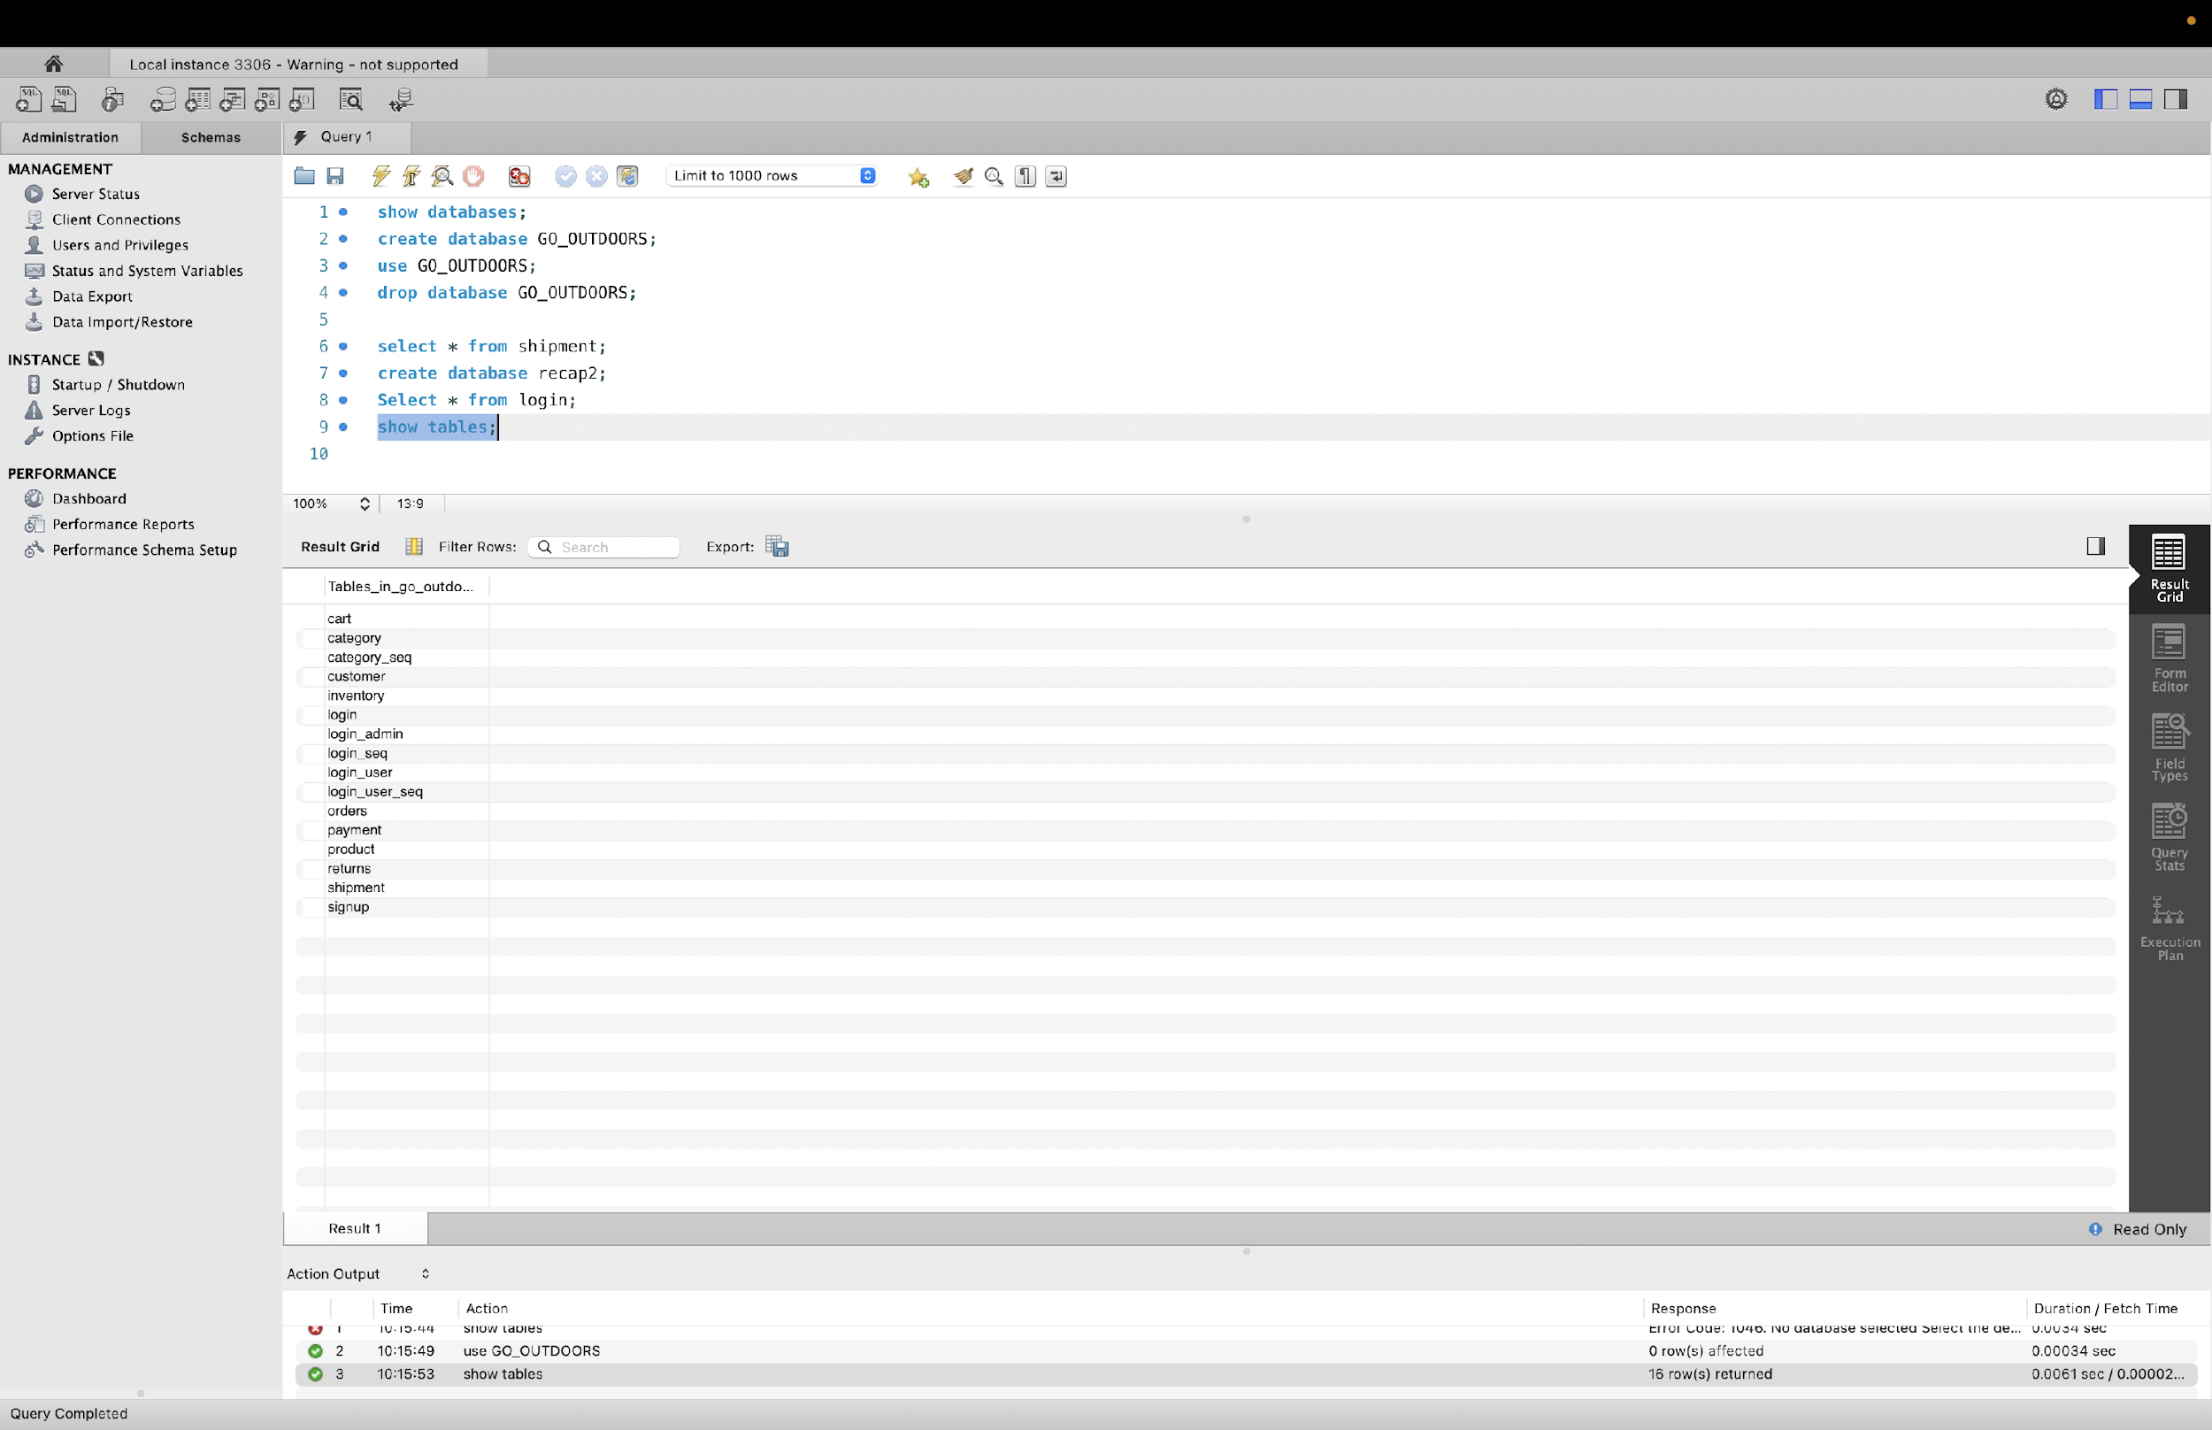
The database created and stored on MYSQL

Slide 38
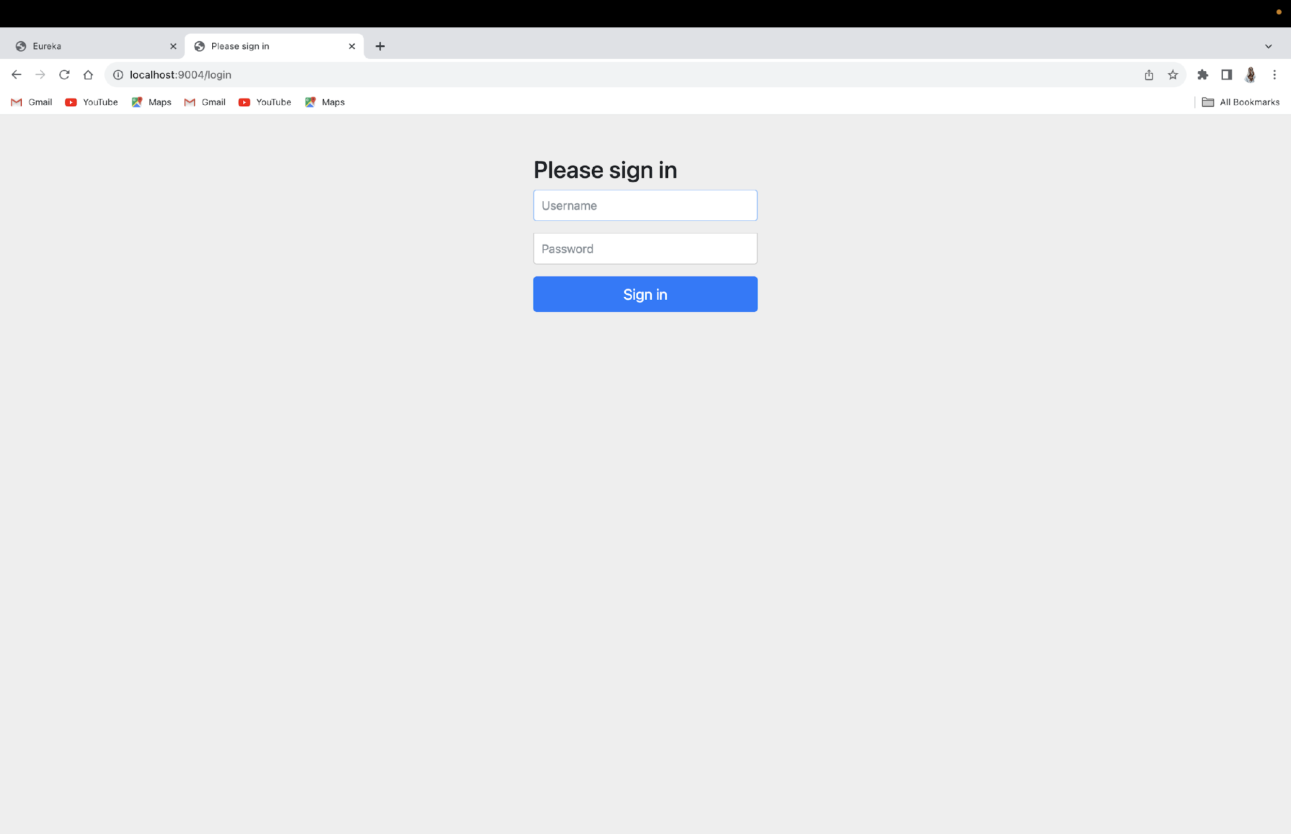
The login page

Slide 39
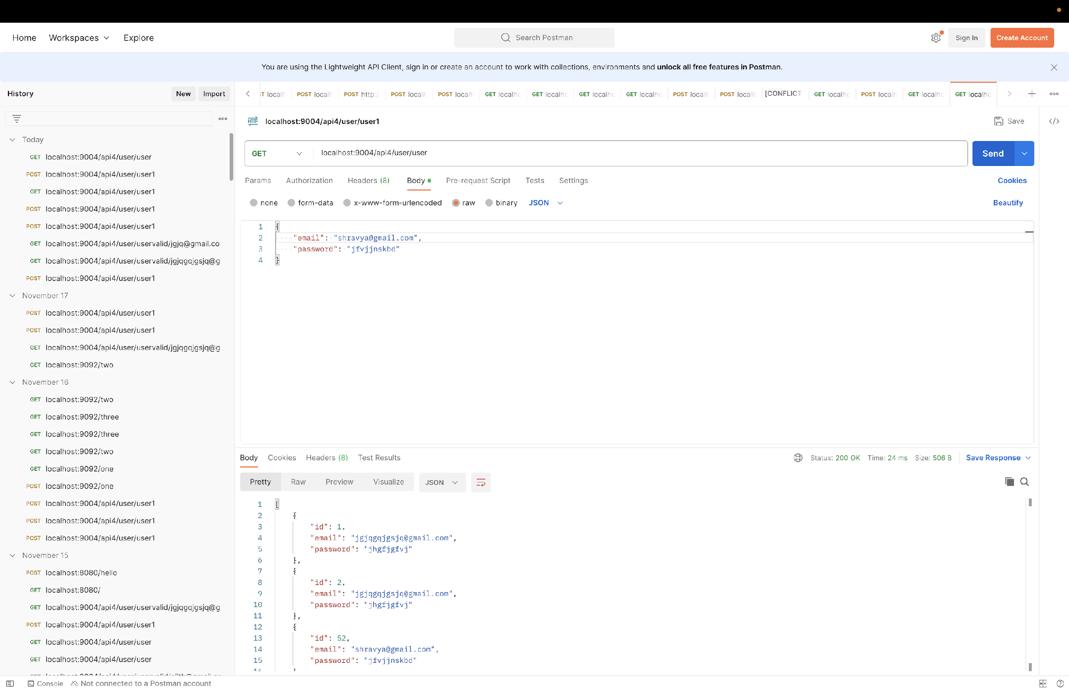
The CRUD Operations on Postman

Slide 40
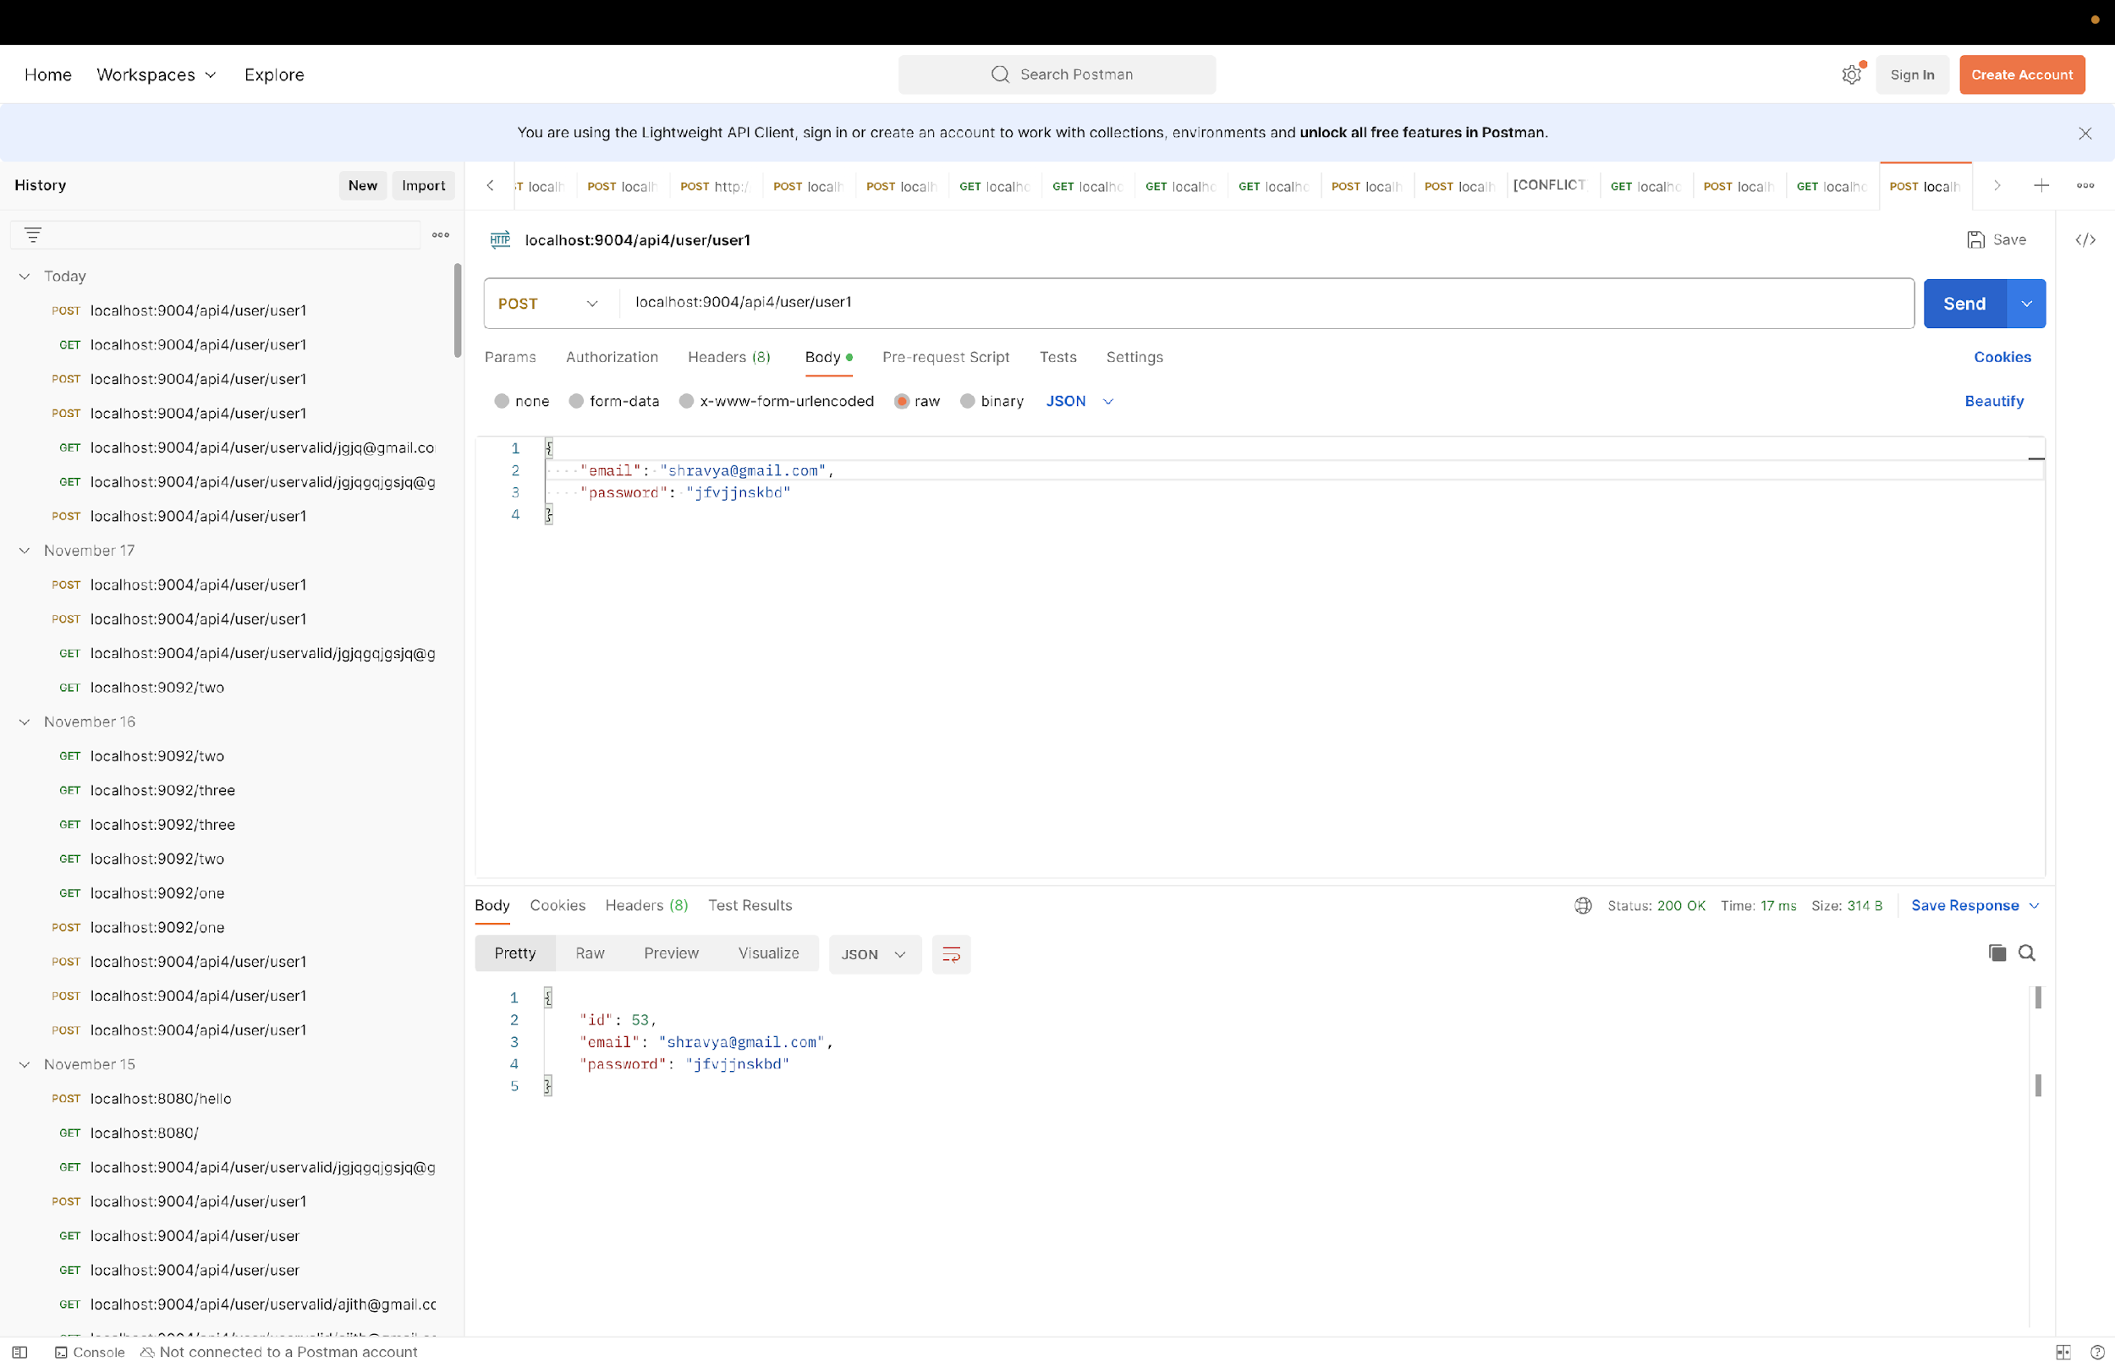

Slide 41
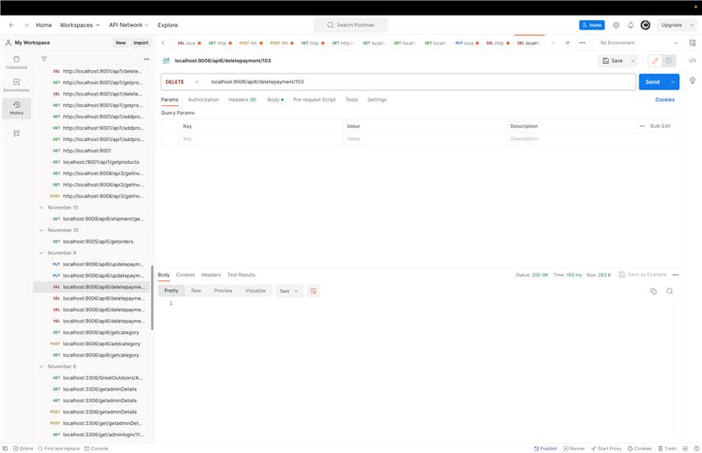

Slide 42
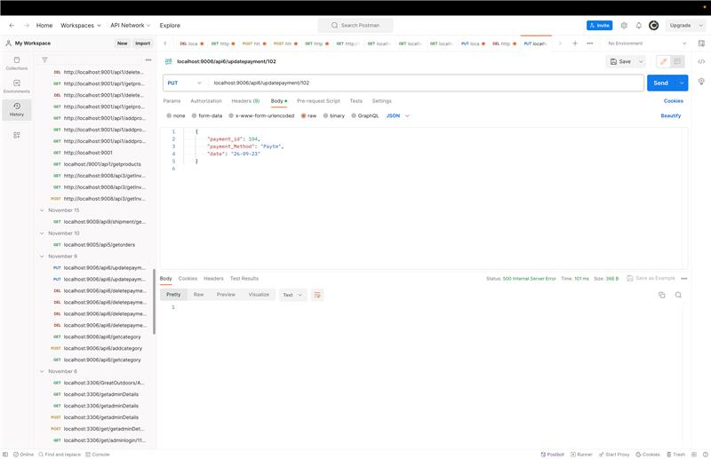

Slide 43
PROGRESS
We designed Use case diagram, E-R Diagram, Class diagram and Architecture
We created 10 microservices with different architecture layers such as controller, entity, repository, exception.
We worked on CRUD Operations and entities for each microservices.
We worked on different testcases for different microservices.
We worked on exception for login microservice
We worked on Authentication, Authorization and Spring Security

Slide 44

THANK YOU

